Slide 1
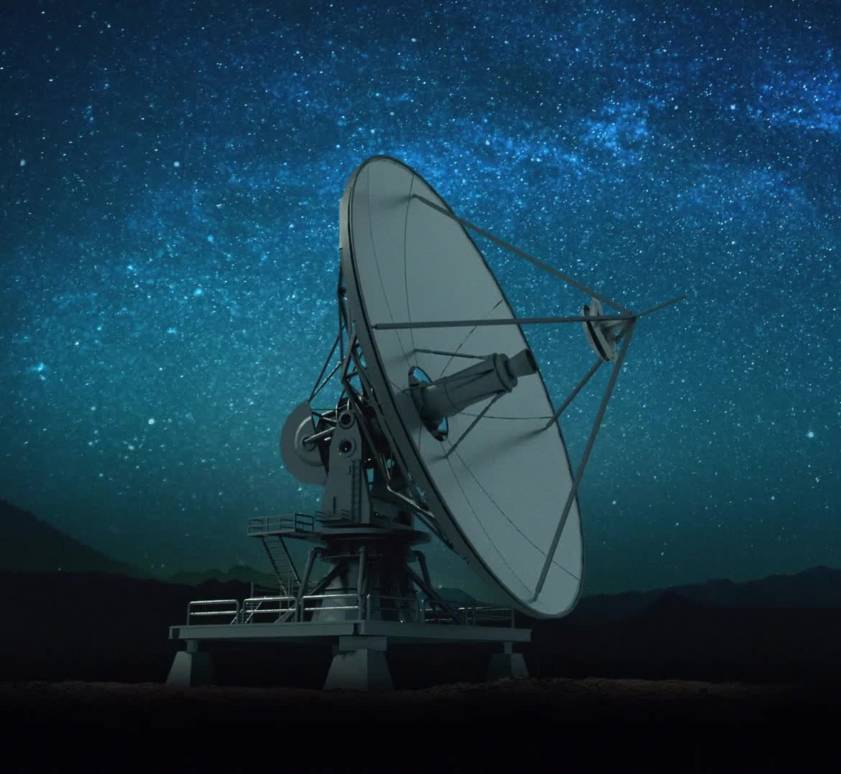

Satellite Image Classification
Kevin Egocheaga
Data Science Career Track Third Capstone Project

Slide 2

Problem Statement and Task
Given the significant progress made in the past several years on remote sensing (RS) image interpretation and its numerous applications, I decided to work with an RS image dataset, utilizing deep learning models –in specific, convolutional neural networks (CNN)– to classify images into their respective classes.
I trained and employed a deep-learning model to predict image classes. The task consisted of four phases –namely: (1) sourcing and loading, (2) preprocessing, (3) training, and (4) data augmentation and dropout.

Slide 3
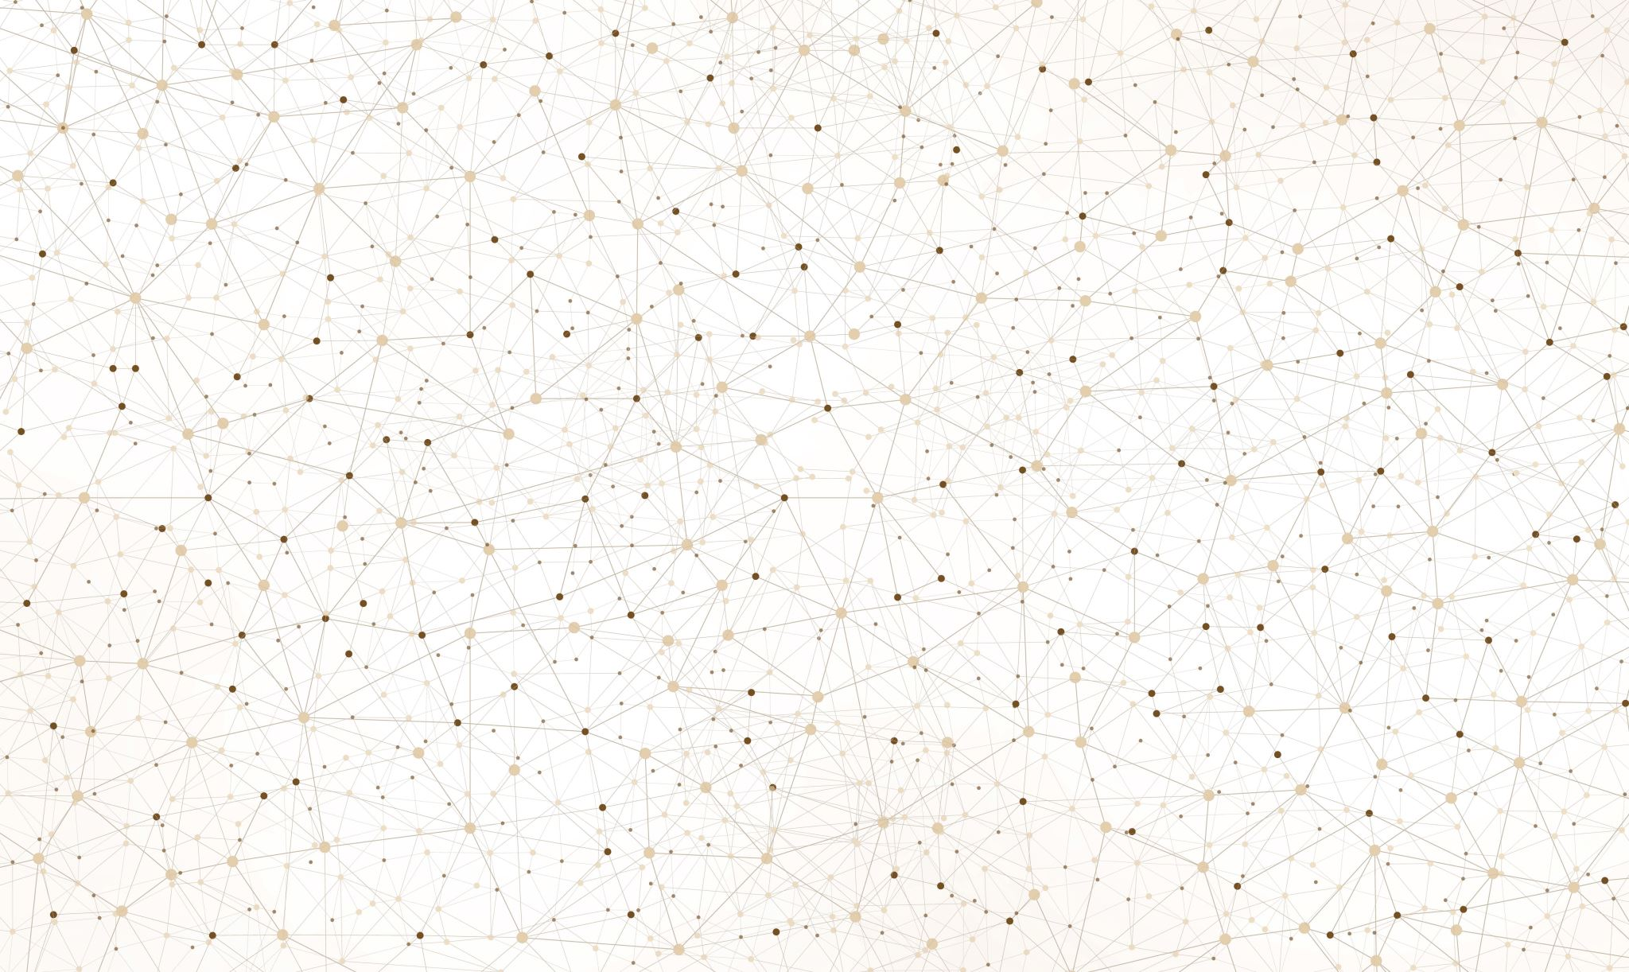







Who might be interested?

Slide 4
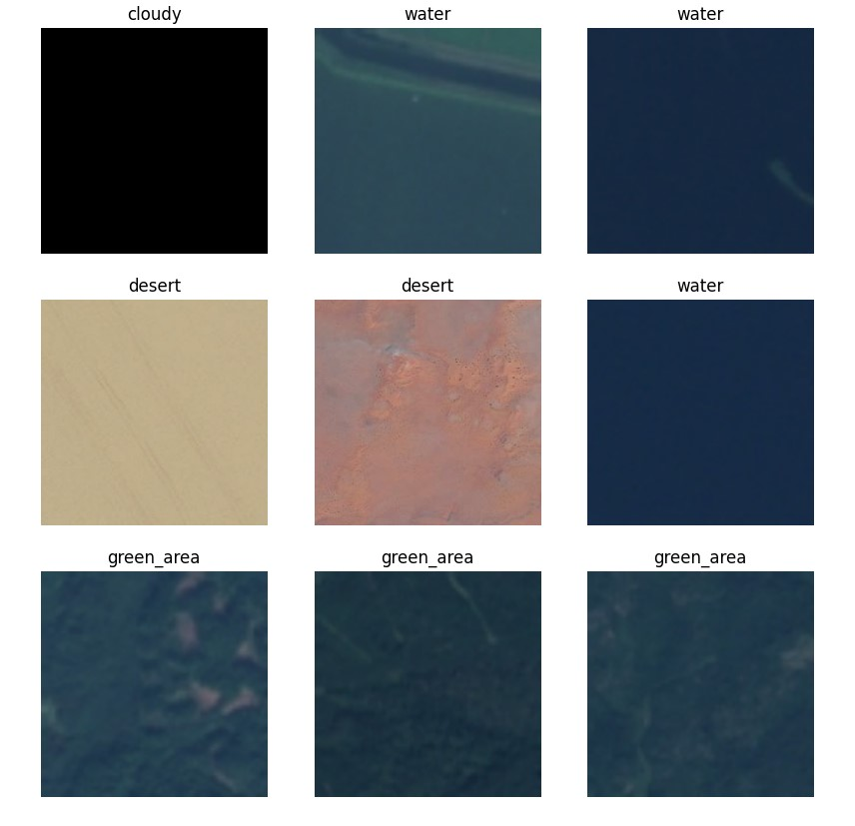

Data Set and Image Classes
The data set consists of 5,554 images and four classes.
All images are of natural phenomena. The four classes are titled: (1) cloudy, (2) water, (3) desert, and (4) green_area.
Images were split between training set and validation set, with the validation set accounting for 30% of overall data set.

Slide 5
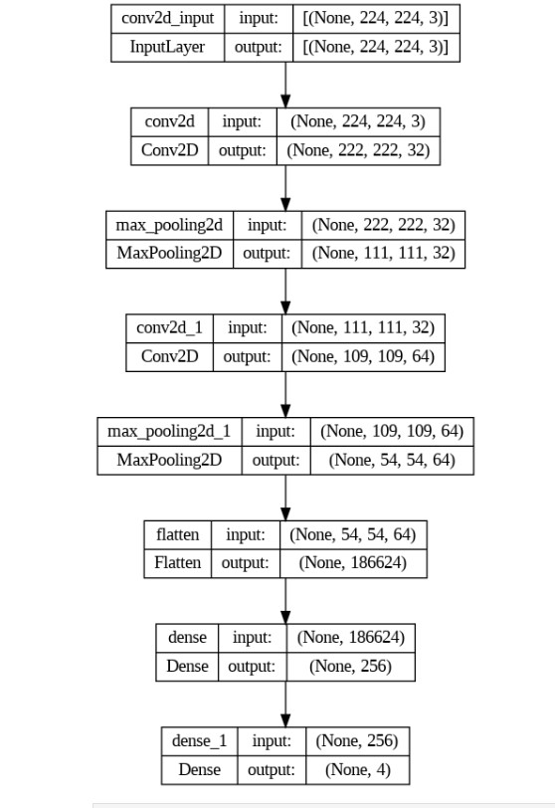
Preprocessing and Base Model’s Architecture
Guiding questions: (1) How many convolutional layers do I want? (2) What should be the activation function for each layer? And (3) How many hidden units should each layer have?
Answers: (1) The model’s architecture was to have six hidden layers with three convolutional layers. Each convolutional layer is followed by a maxpooling layer. Also, I added a flatten layer before the output layer. (2) I used the relu activation function for its use-case generality. (3) The number of hidden units doubled with each consecutive convolutional layer.

Slide 6
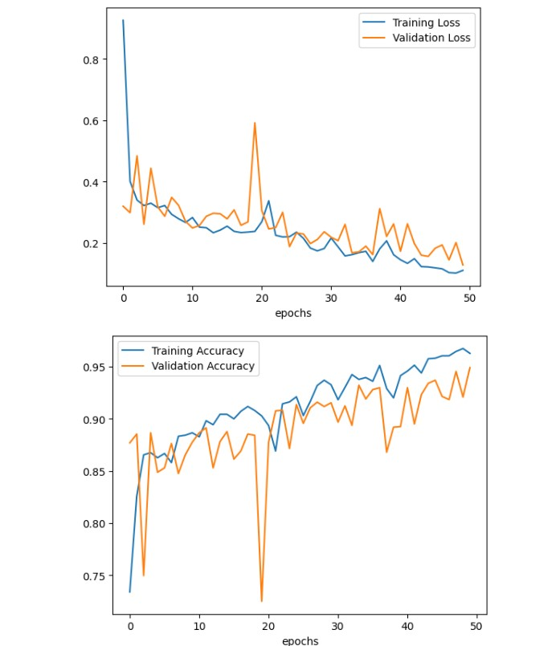
Training Base Model
Focus: To train base model with both the training and validation set.
Compiled model using adam optimizer, using sparsecategoricalcrossentropy as lost function, and getting the accuracy as the metric.
The model ran for 50 epochs. Visual plots were created on training loss vs. validation loss and training accuracy vs. validation accuracy.
The base CNN model performed very well, with a total accuracy of about 96%.
To prevent overfitting, another CNN model was created.

Slide 7
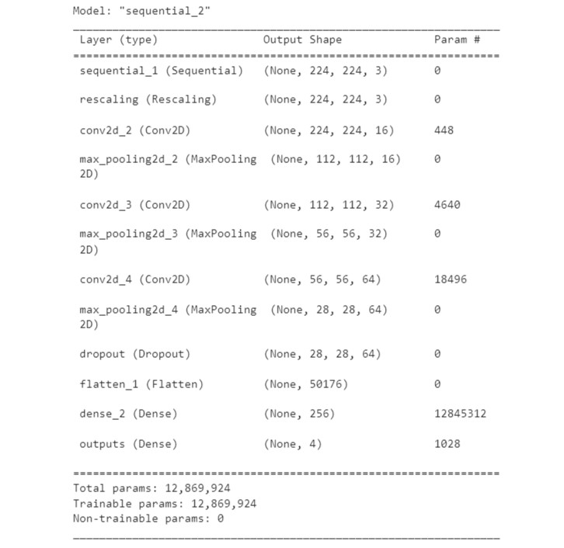
Data Augmentation and Dropout
Objective: To improve upon base CNN model using two methods: (1) Data Augmentation and (2) Dropout.
I used data augmentation to generate additional training data from the existing images by augmenting them using random transformations that yield believable-looking images. By adding additional images to the data set, the model will likely train more efficiently and, in turn, generalize better
I added a dropout layer to enhanced CNN model to prevent overfitting.

Slide 8
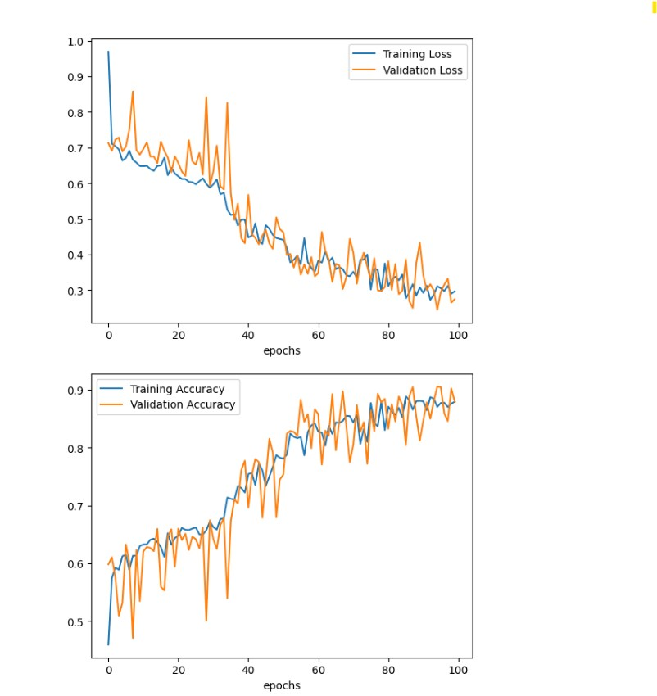
Results
The new CNN model was run for 100 epochs.
The model’s performance did not improve. In fact, the performance decreased to about 88%.
However, the new model’s performance shows signs of genuine pattern recognition, rather than overfitting.

Slide 9
Takeaways
The CNN models classified the images very well. The performance wasn’t improved on the dropout CNN model, but with certain changes, performance on the dropout CNN model is likely to improve beyond that of base model.
As to generalization, the model was not checked on a training data set, as one was not offered from the source of the data. Data was assessed solely on a validation data. However, generalization can be easily accounted for with the introduction of new data.

Slide 10
Thank you!
Kevin Egocheaga
Aspiring Data Scientist
Contact Information:
Email: kegocheaga@yahoo.com
LinkedIn: https://www.linkedin.com/in/kevinmegocheaga/
GitHub: https://github.com/kevinegoch

